Slide 1
Account Administrator Overview

Slide 2
Features
Price Controls
Date Controls
Inventory Controls
Custom Reports
Form Creator
Internal E-Mail Function

Slide 3
Constructing a Payment Item
An item is given a Name and optional Item Number
The Order in which it appears on the parent screen is set
Inventory Control can be used to limit enrollment
Items can appear when made contingent on other items
A Custom Description field is used to provide details
An Image or Document Upload connects a file to the item

Slide 5
Constructing a Payment Item

Slide 6
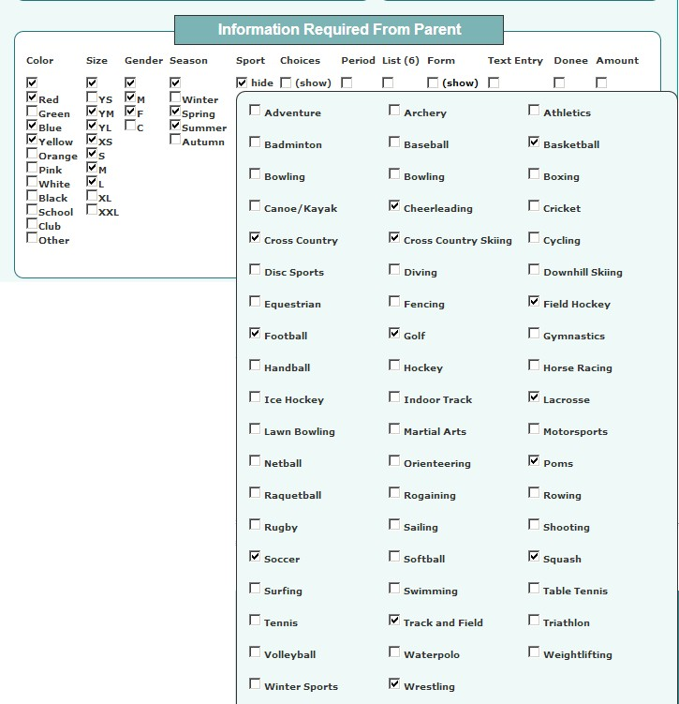
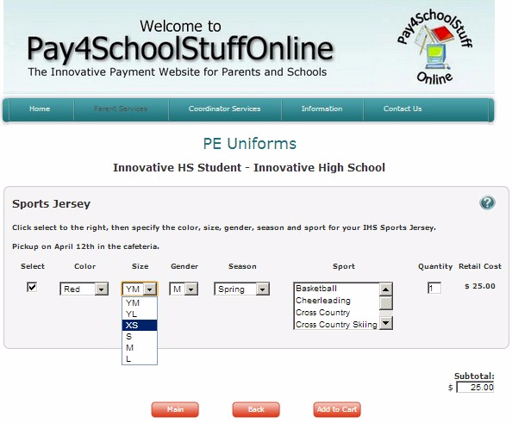
Sizes ,Colors, Gender, Sports, Season, and Text Entry options provide a full range of customization and the flexibility needed to describe, list, and solicit the required feedback from the parent.
By selecting the Color, Size, Gender, Season or Sport features, items that are checked will be available in a drop-down list for the parent to select from. Selecting the Text Entry option requires the parent to submit text in a box provided.
Administrator view of selections. Parent view of the item, with defined drop-downs.
Notes:
Skim through this quickly. Not as relevant for central office staff.

Slide 7
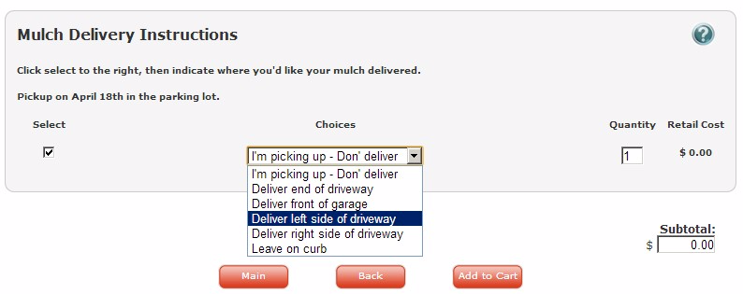
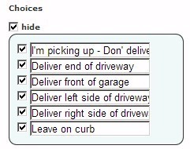
Administrator view of Choices feature
Parent view of the item, with defined choices.
Notes:
Use of the Choices feature allows the Administrator to specify up to 6 items for the parent to choose from.

Slide 8
Form Creator
The Form Creator feature allows Account Administrators to design and deploy forms associated with their items and eliminate the use of paper forms

Slide 9
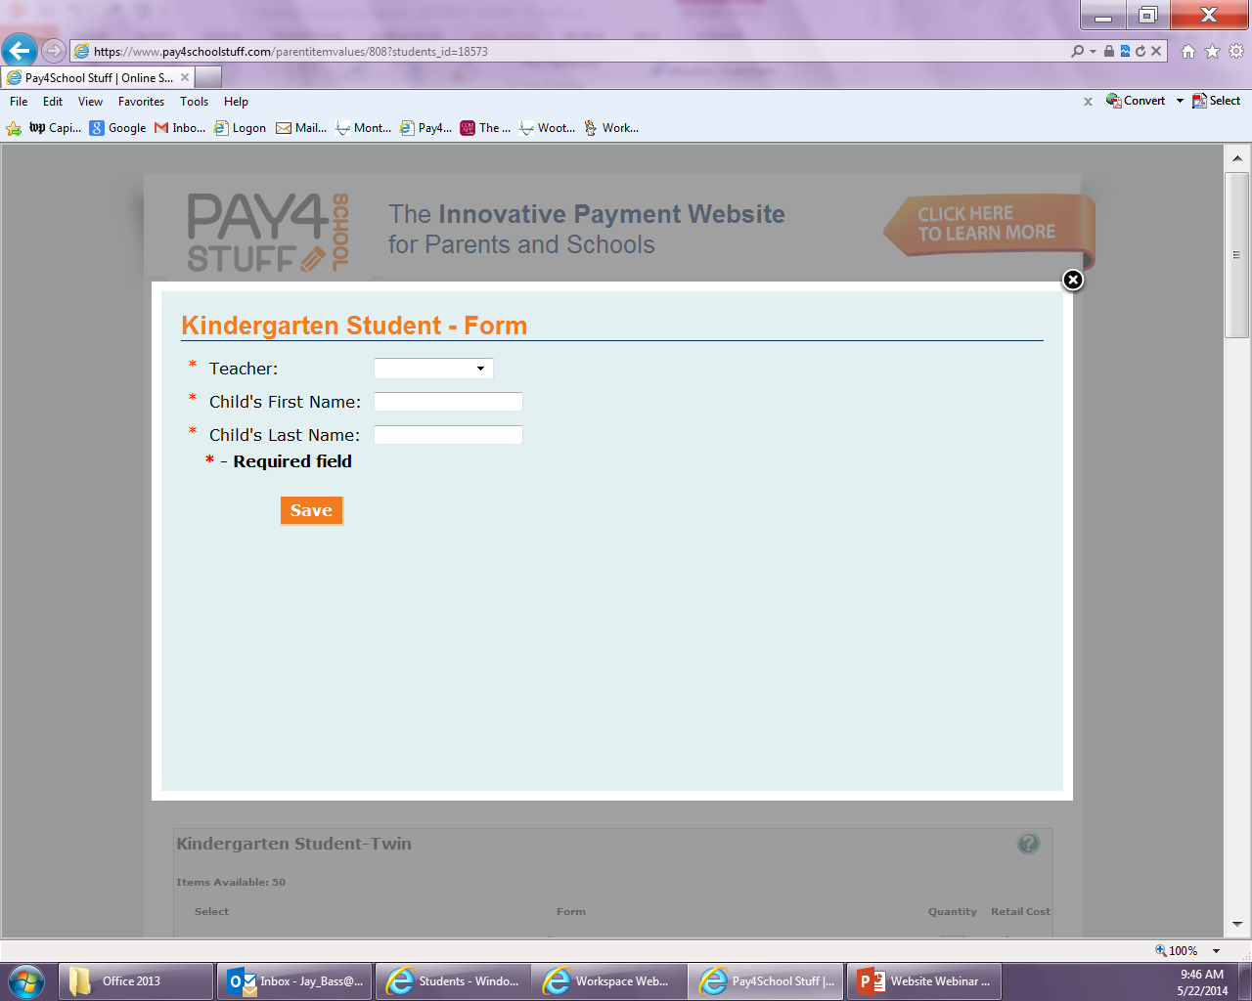

Slide 10
Price Controls
Items can be listed for a specific pre-defined price, for an amount entered by the parent, or at no cost
No-cost items can collect information
Administrators dictate the final retail cost and how the processing fees are distributed.

Slide 11
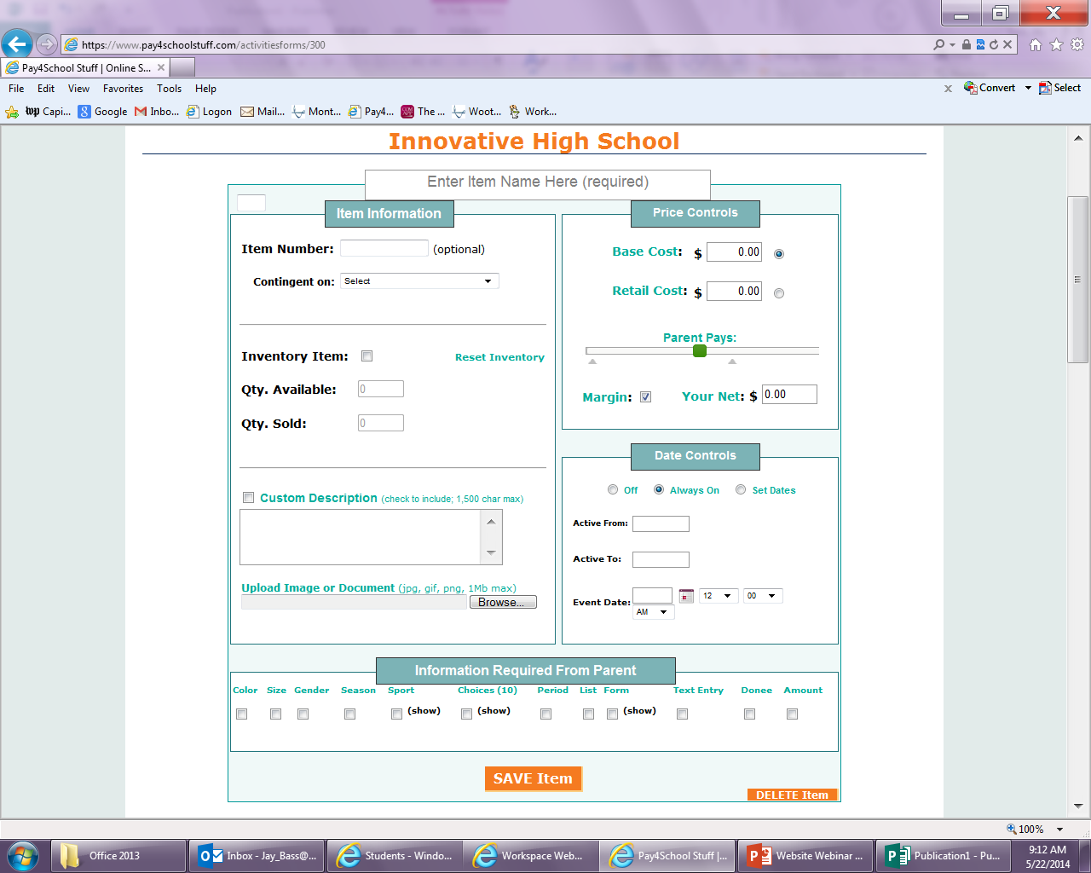

Slide 12
Price Controls
Administrators can specify a Base Cost, upon which the processing fees are calculated, or the Retail Cost, which includes the processing fees.
A slider can be used to indicate what proportion of the fees are paid by the parent.
In these costs are left at “0.00”, the item will be listed as a no-cost item.
Current processing fees are 3.75% + $0.16/item. The parent only sees a final retail price.

Slide 13
Date Controls
Items are programmed to be off, always on, or use set dates to specify the date and time when items will be visible and available for parents to purchase.
If the event date and time are specified, these will appear as part of the item listing.

Slide 14
Inventory Controls
Setting the Inventory Control for an item can control the amount of items that are sold.
E-mails will be sent to the Account Administrator responsible for this item when the inventory reaches 5, and when it hits 0 (and will turn the item off).
Notes:
Explain e-mails at 5 and 0.

Slide 15
File Upload/Custom Description
.PNG, .JPG, and .TIF files can be uploaded for parents to view and/or print.
Custom Descriptions can be written to provide instructions, guidelines, and other details to parents for each item.

Slide 16
Reporting/Reconciliation
Pay4SchoolStuff.com has flexible and robust reporting capabilities for both parents and school administrators.
Administrators can easily generate reports based on date ranges for specific items, students, parents, or administrative positions using the Report Generation Tool.

Slide 20
Architecture
No practical concurrent user limits or special bandwidth requirements.
Any device with an active internet connection can access and use the site.
Fully supported for all mobile devices using Google Chrome.

Slide 21
Architecture
Three functional areas for administrators:
Select or Edit Items
Generate Reports
Edit Account
Drop-down menus provide access to all system functions from any screen.
Information and guidance for getting started and using the system is available online.

Slide 22
Account Management
“Report-Only” logins are provided for each position, allowing those that only need to generate reports to access the reporting tool.
Account management tasks are minimal.

Slide 23
Questions?
E-mail us at
info@pay4schoolstuff.com
or call (877) 397-2937

